Slide 1

Sagar Institute of Research &Technology
9001-2008 ISO Certified Institute of MP
MAJOR PROJECT ON
Programmable Energy Meter With Bill Estimation
BRANCH : EC[7TH SEM ]
Academic session : 2022-2023
Project by…
Under The Guidance of..
Shruti Nodia (0133EC191101)
Siddharth Yadav (0133EC191108)
Suhana khan (0133EC191110)
Vishal bhumarkar (0133EC191122)
Professor
Shalinisahay

Slide 2
Table of content
Introduction
Description
Block diagram
Design of the system
Software required
Advantages and disadvantages
Conclusion
Future scope
reference

Slide 3
Introduction
1.embedded system is a combination of software and hardware to perform a dedicated task. Some of the main devices used in embedded products are microprocessors and micro-controllers.
2.An embedded system is a computer system designed to perform one or more dedicated functions often with real-time computing constraints .
3. By contrast , a general-purpose computer , such as personal computer (PC), is designed to be flexible and to meeta wide range of end-user needs .

Slide 4
Description of project
The main aim of the Programmable energy meter project is to estimate energy consumed by load with the help of at meg and calculate the cost.
Energy meter gives pulses which will be counted and displayed on LCD. These pulses occur depending on energy consumed.
GSM to send SMS on amount of energy consumed.
12V Transformer to give power supply to the system. The user needs to make call which.6/21 be received and displayed on LCD and stored.
In this design, the hardware components thatwe use are:
GSM MODULE • TRANSFORMER
ULN2003A (RELAY DRIVER) • Relay
ENERGY METER• OPTO COUPLER

Slide 5
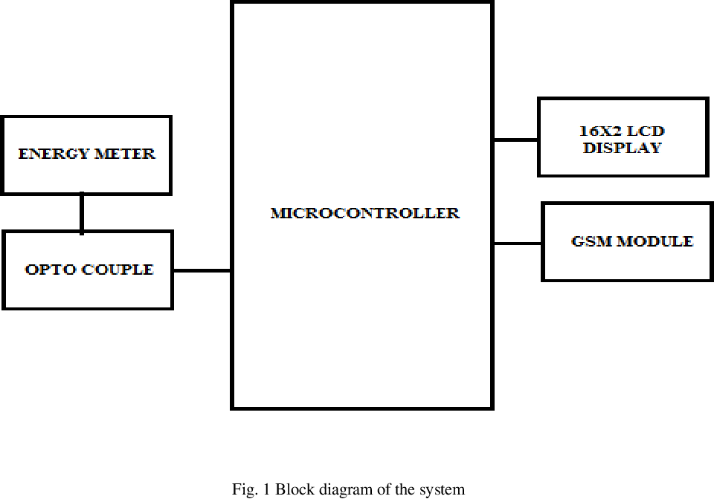
Block diagram

Slide 6
Design of the system
The Embedded system designed is Programmable Energy Meter With Bill Estimation using GSM module.
This Project is designed with latest and most demanding technology that is embedded system.
In this project we will use GSM based programmable energy meter to solve statistical errors overcome in the process of monthly billing.
This will help in a huge reduction of power thefts as well to analyze average power consumption of a certain locality.

Slide 7
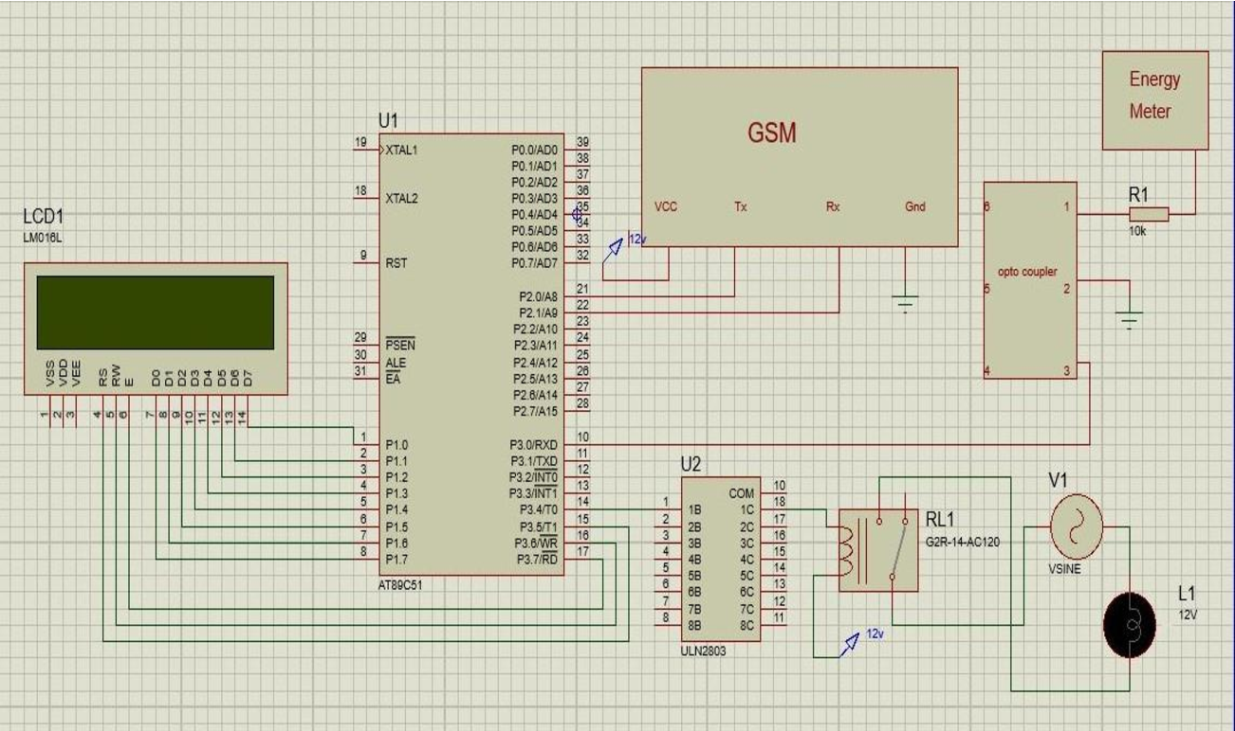
SCHEMATIC DIAGRAM

Slide 8
Software required
Compilers are programs used to convert a High Level Language to object code. Desktop compilers produce an output object code for the underlying microprocessor, but not for other microprocessors.
The programs written in one of the HLL like 'C' will compile the code to run on the system for a particular processor like x86 (underlying microprocessor in the computer).
For example compilers for Dos platform is different from the Compilers for UNIX platform.
The Proteus is an electronic circuit design software which includes a schematic capture, simulation and PCB (Printed Circuit Board) Layout modules.

Slide 9
Advantages
1. This reduces the large number of lab our operators/employees and long hours to accomplish the task and errors done by humans.
2. Less time consuming, Economical and simple to use.
3. This is going to help the customers to reduce their power bill by managing their energy consumption.

Slide 10
Disadvantages
1. Network Problem 15/212.
2. Circuit Complexity.
3. Implementation cost is high.

Slide 11
Conclusion
GSM is beneficial for both energy provider and customer. This reduces the manual cost and also reduces the errors done by the humans.
This helps the consumer to reduce the number of units.
This system can be used even in the remote areas by changing the type of the modem and its range of frequency for communication .
This device reduces all the cases of revenue problems to the country and helps us to improve our usage.

Slide 12
Future scope
In future we can also update the tariff within the energy meter by writing a program in the java and it must be connected to the energy meter using USB port which automatically updates the program in the microcontroller.
This makes flexible for both user and the company.

Slide 13
Reference
H.G. Rodney Tan, C.H. Lee, and V.H. Mok Design and Implementation of Automatic Meter Reading System Using GSM,ZIGBEE through GPRS, International Journal of Advanced Researching Computer Science and SoftwareEngineering,vol2, edition 5, May2012.
Yujun Bao and Xiaoyan Jiang, "Design of electric Energy Meter for long distance data information transfers based upon GPRS",ISA 2009. International Workshop on Intelligent Systems and Applications, 2009.
3. Subhashish Maitra, "Embedded Energy Meter- A new concept to measure the energy consumed by a con- sumer and to pay the bill” , Power System Technology and IEEE Power India Conference, 2008

Slide 14
Thank you

